Slide 1




Custodians of the Web
Operating Systems and Security

Slide 2

Agenda
Windows vs. Linux Security
User Permissions and Access Control
Introduction to Encryption
Practical Activity: Create and Manage User Accounts in Linux

Slide 3

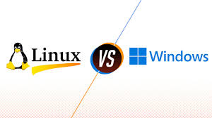
Linux vs. Windows Security

Slide 4

Comparison
Windows | Linux
Built-in antivirus (Windows Defender) User Account Control (UAC) BitLocker for disk encryption Regular security updates via Windows Update User-friendly, widely targeted by malware | Open-source nature allows for community-driven security audits SELinux (Security-Enhanced Linux) for access control Built-in firewall (iptables/ufw) Minimal use of root account reduces attack surface Highly customizable, less prone to malware

Slide 5


User Permissions and Access Control
What are User Permissions?
Rules that define what a user can or cannot do on a system.
Types of Permissions:
Read (r): View files or directories.
Write (w): Modify files or directories.
Execute (x): Run files or access directories.
Access Control Models:
Discretionary Access Control (DAC): Owner decides permissions.
Mandatory Access Control (MAC): System-wide policies enforce permissions.
Examples:
Windows: NTFS permissions, Group Policy.
Linux: File permissions (chmod), Access Control Lists (ACLs).

Slide 6
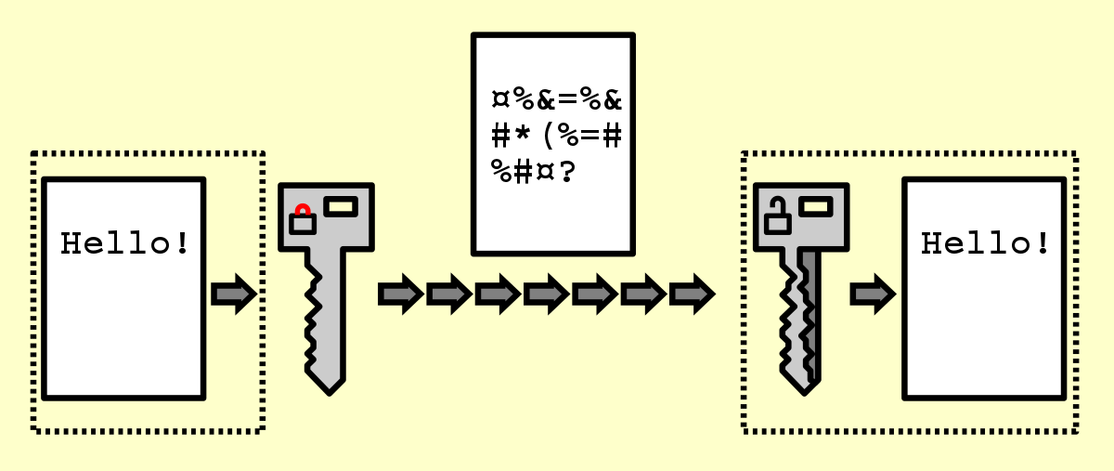
Introduction to Encryption

Slide 7
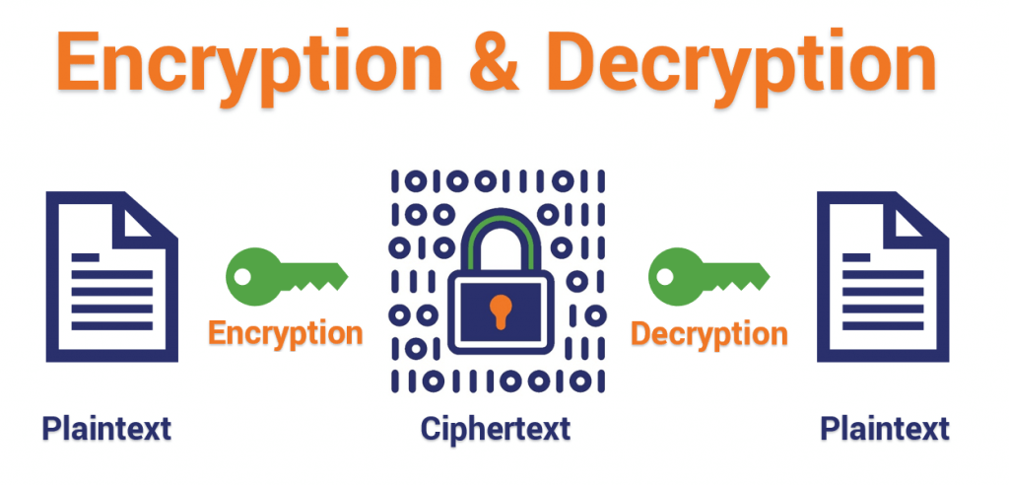

Slide 8
What is Encryption ?
Process of converting data into a coded format to prevent unauthorized access.
Types of Encryption:
Symmetric Encryption: Single key for encryption and decryption (e.g., AES).
Asymmetric Encryption: Public and private key pair (e.g., RSA).
Common Uses:
Securing communication (SSL/TLS).
Encrypting files and disks (BitLocker, LUKS).
Protecting passwords (hashing).

Slide 9


Slide 10
Practical Activity - Creating and Managing User Accounts in Linux- Screen Recording

Slide 11
Thank You...

