Slide 1




Custodians of the Web
Web Application Security

Slide 2

Agenda
Common vulnerabilities (e.g., SQL injection, XSS).
Secure coding practices.
Introduction to OWASP Top 10
Using tools like Burp Suite to test for SQL injection vulnerabilities in a demo web app.

Slide 3


What is Web Application Security?
Web application security is the process of protecting websites and online services from cyber threats.
Why it matters: "Hackers can steal data, break websites, or harm users if security is weak."

Slide 4


Common Vulnerabilities
SQL Injection: "Hackers insert malicious code into a website's database."
Cross-Site Scripting (XSS): "Hackers inject harmful scripts into websites to attack users."
Example: "Imagine someone stealing your login details or posting fake messages on a website."

Slide 5



Secure Coding Practices
Input Validation: "Check all user inputs to block harmful data."
Use Prepared Statements: "Prevents SQL injection by separating code from data."
Escape Special Characters: "Stops XSS attacks by neutralizing harmful scripts."
Keep Software Updated: "Fixes known security holes."

Slide 6
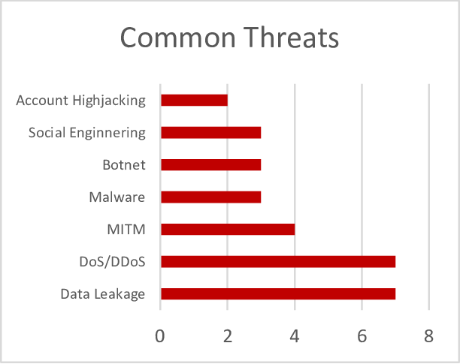
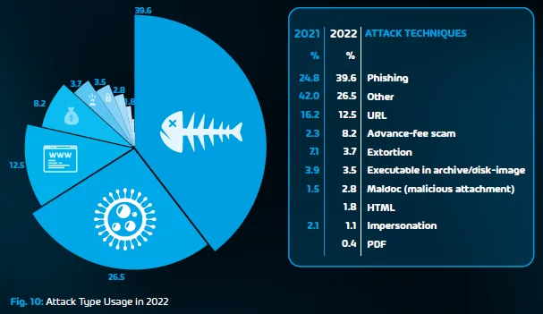
Introduction to OWASP Top 10
What is OWASP?: "Open Web Application Security Project – a list of the top 10 most critical web vulnerabilities."
Examples: SQL Injection, XSS, Broken Authentication, Sensitive Data Exposure.
Why it’s important: "Helps developers know what to watch out for."

Slide 7

Burp Suite to Test for SQL Injection Vulnerabilities in a Demo Web App
Set up Burp Suite and configure your browser to use it as a proxy.
Navigate the target web application through Burp.
Intercept HTTP requests using the Burp Proxy.
Send suspicious requests to Burp Repeater to test different SQL payloads.
Use Burp Scanner (Pro version) for automated vulnerability scanning.
Observe responses for SQL error messages or unexpected behaviors.

Slide 8
Thank You...

